Slide 1









VISUALIZATION OF TENNIS GRAND SLAM WINNERS
Project 3
Cathy
Rachael
Aria
Raymond

Slide 2

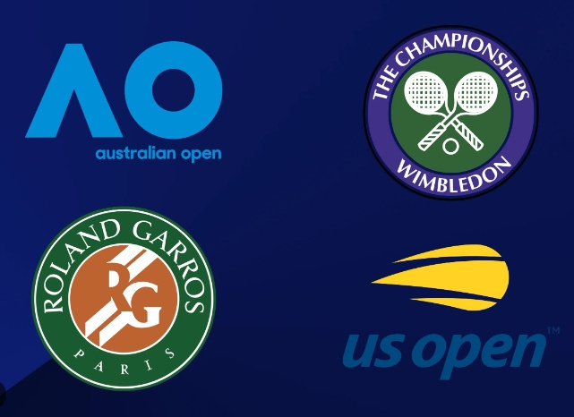
Introduction of the Grand Slam

Slide 3
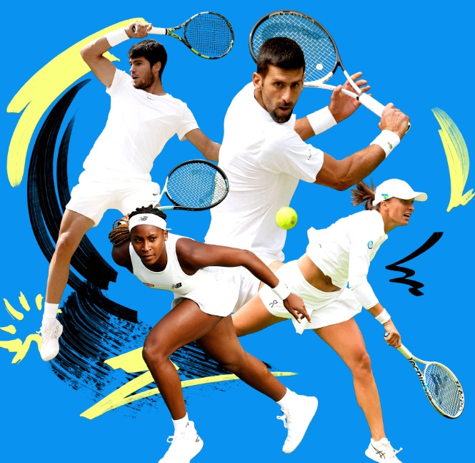
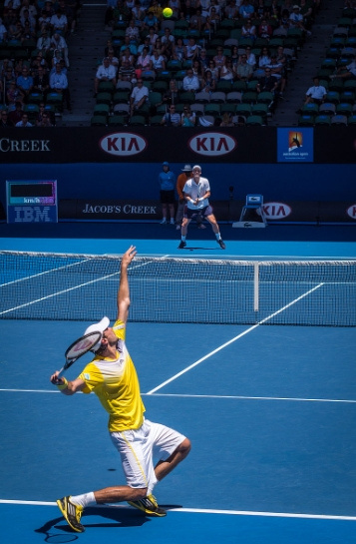
Overview of the project and its purpose
Purpose: Develop a tennis data dashboard for easy exploration of Grand Slam data.
Inspired by the recent US Open, highlighting the potential of data-driven insights in tennis.
Showcase trends in country distributions of winners, player performances, and winning patterns.

Slide 4

Overview of the project and its purpose
Visualize and analyze historical data of Men's Tennis Grand Slam winners.
Incorporate various statistics like tournament outcomes, player and country performance using interactive visualizations (maps, bubble chart, sunburst chart).
Goal: Make the data accessible and easily interpretable for tennis fans, analysts, and researchers, providing valuable insights into tennis history.
2024 US Open Champion - Jannik Sinner

Slide 5

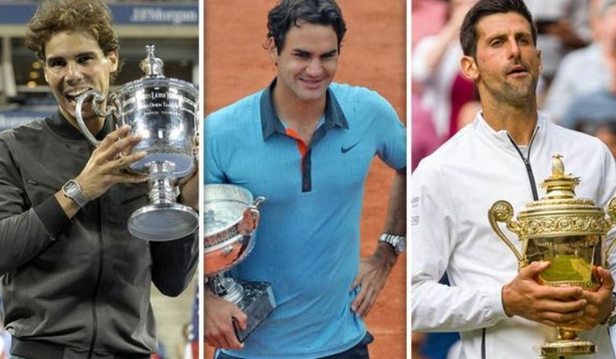
ETHICAL CONSIDERATIONS
Public data used: Player statistics, match results, tournament information
Non-public data avoided: Personal information, private earnings, medical records
Ensured compliance with data ethics: No sensitive data used

Slide 6
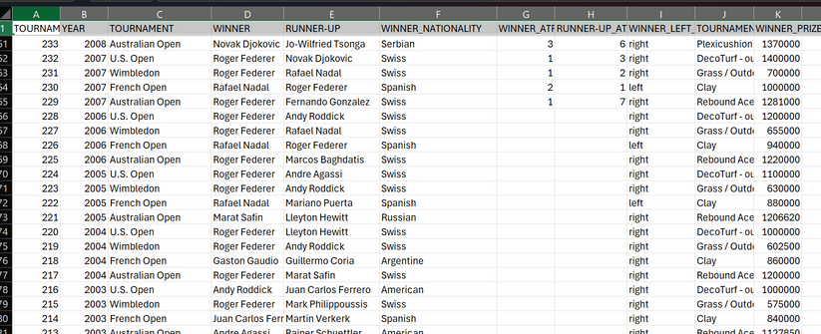

CLEANING AND SORTING DATA
Using the CSV files from Kaggle we:
Identified that there were missing values in the CSV files
Kept the column with empty values as this provided information about players ranking.
Observed the data and cleaned this prior to moving to SQL database.
Added a new column to establish a serialised column.
Standardised the data: inconsistencies across tables.
There were duplicates and removed these from the data (foreign keys and primary keys).

Slide 7
WHAT WE DID NEXT..
Created a Quick DBD ERD Diagram
Created a database in Postgres SQL
Uploaded CSV files into the “GS Tennis Database”
Merged the three tables
Exported into a JSON file
JavaScript to access the JSON file and to create the interactive diagrams
Used multiple libraries
HTML & CSS: These were used to structure and style the web page that hosts our dashboards
\

Slide 8
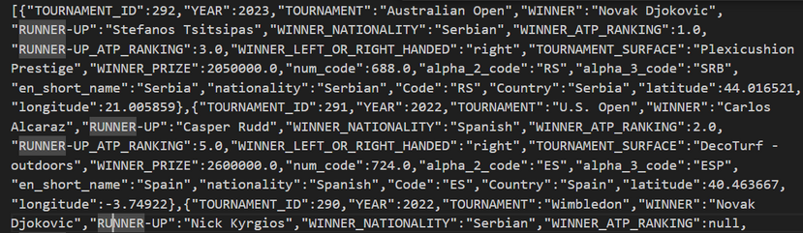
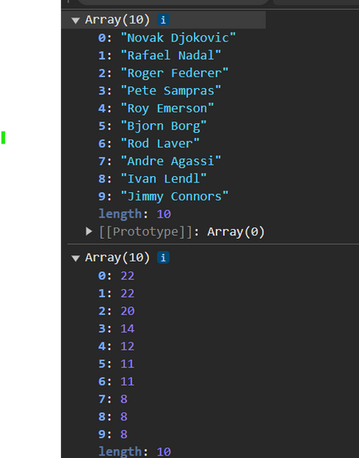
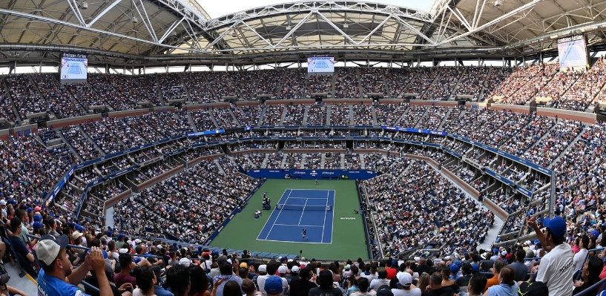
Bubble Chart
Grand Slam Tennis (rachaelinnes.github.io)
Interactivity: Plotly provides interactive charts that allow users to zoom, pan, and hover over data points to get more information. This makes the visualization more engaging and user-friendly.
Data Preparation: arrays for the indices, winner names, and number of wins
Integration with D3.js: Plotly can work seamlessly with D3.js, allowing you to fetch and manipulate data using D3.js and then visualize it with Plotly.

Slide 9
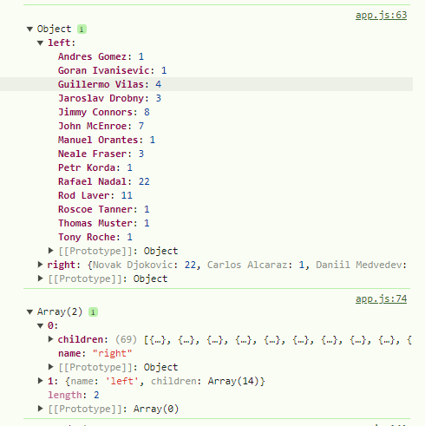
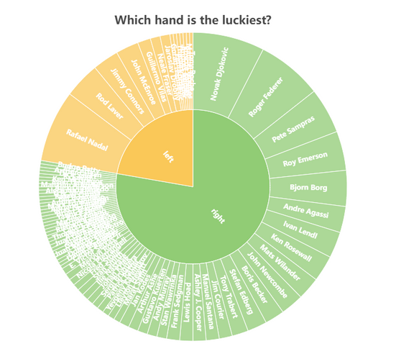
Sunburst Chart
Grand Slam Tennis (rachaelinnes.github.io)
Apache ECharts library - complex
Transformed json format data
Convenience of passing an array of nested objects based on category
Single array of nested objects - key value pairs
Plotly uses 3 arrays - parent/child but handles font sizing better

Slide 10
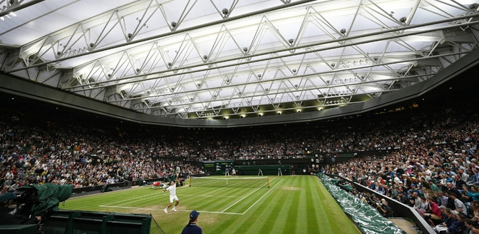
Grand Slam Data Panel
Grand Slam Tennis (rachaelinnes.github.io)
extracted JSON data was filtered to present mostly tennis info to our user
e.g. removed latitude, longitude and prize money because that data was scraped from espn website
presents like a timeline.

Slide 11
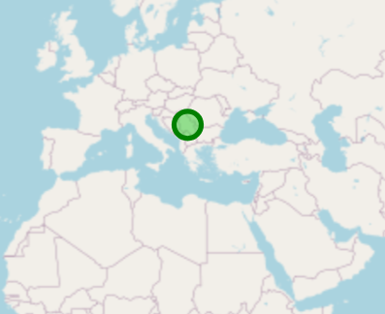
MAPPING PLAYERS
The Coding approach:
Data Fetching:
JavaScript to fetch data from a JSON file containing information about the tournament winners, their nationalities, and other relevant details.
Filtering Data:
Implement a filter to select a specific Grand Slam tournament (e.g., Australian Open, French Open, Wimbledon, US Open).
Library:
Leaflet is a well documented Javascript library.
User friendly (can be used on devices)
Grand Slam Tennis (rachaelinnes.github.io)

Slide 12

MAPPING PLAYERS
Why this code?..
D3: is excellent for creating complex and interactive data visualizations.
It provides a lot of flexibility and control over the visual elements
Allowing you to create highly customized visualizations.
Grand Slam Tennis (rachaelinnes.github.io)

Slide 13
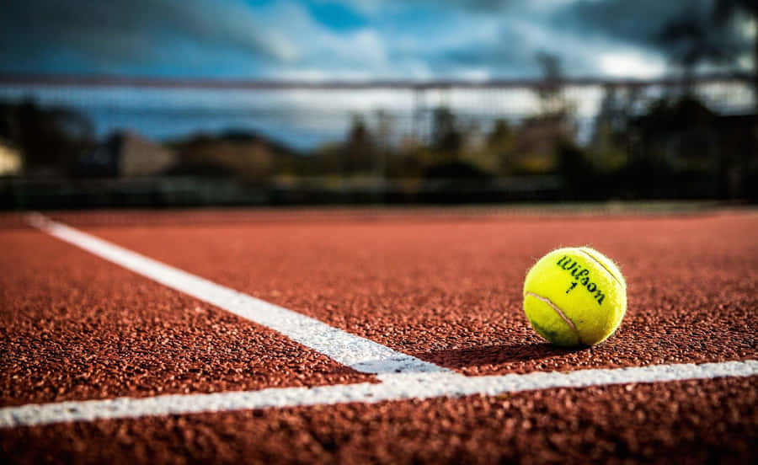
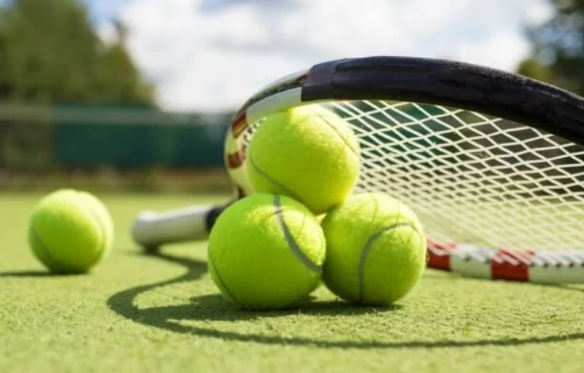
MENS TENNIS DASHBOARD
Grand Slam Tennis (rachaelinnes.github.io)

Slide 14
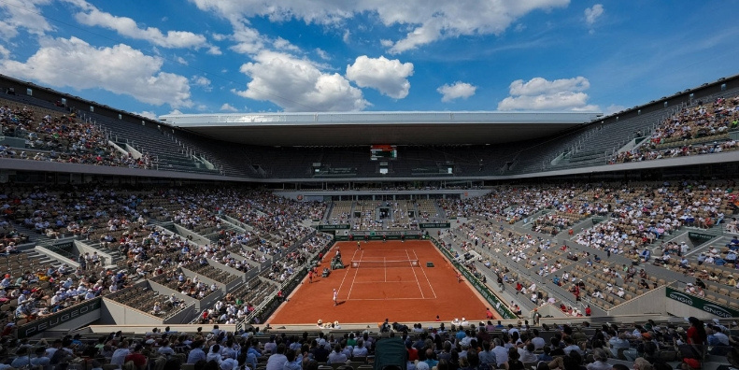
CONCLUSION
We know lots of information we didn’t know before..
Right handed tennis players win most of the Grand Slams
Players from the US have one the most Grand Slams
The three top tennis players are Novak Djokovic, Roger Federer and Rafael Nadal!
Limitation:
Only used mens player data
Limited filtering applied to visuals
Opportunities:
Include all ATP matches
Include winners and semi-finalists

Slide 15
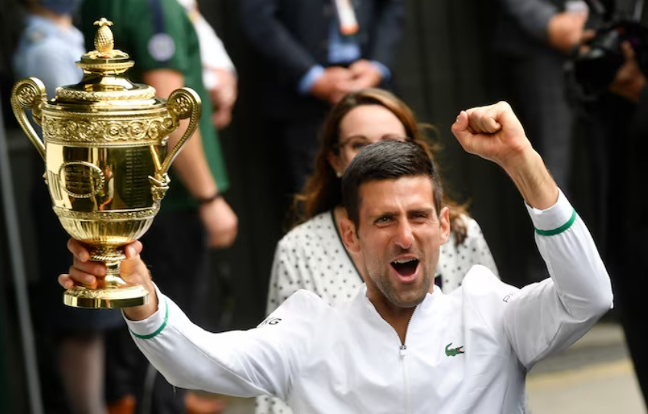
WE WANT TO SAY
THANK YOU
FOR YOUR ATTENTION

